Slide 1
JAX-WS Server-Side Architecture
Service-Oriented Software Engineering
Software Institute
Nanjing University
Bei Jia

Slide 2
JAX-WS Server-Side Architecture
A Java EE 5 container provides deployment services for publishing Web services endpoints and run-time services for processing Web services requests, responses, and faults
  Endpoint Listener and Dispatcher are components largely described by WS-Metadata and WSEE. They are platform specific
  The components that are labeled “SOAP Protocol Binding” and “JAX-WS and JAXB Java/XML Binding” are largely described by the JAX-WS specification
  The meta-data (e.g., deployment descriptors) that get packaged in a WAR or EJB-JAR is largely specified in WSEE

Slide 3
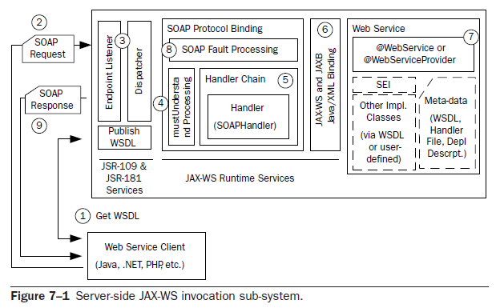
An Invocation Example (1/5)

Slide 4
An Invocation Example (2/5)
The client starts by getting the WSDL for the Web service that has been deployed. WSEE requires that a JAX-WS provider support URL publication
Based on the WSDL, the client composes a SOAP request and does an HTTP POST to the URL specified by the soap:address’s location attribute
The HTTP request containing the SOAP message is received by the Endpoint Listener
  This Listener is a servlet. The process by which the listener servlet is deployed or registered varies by Java EE container and even by type of deployment
  The listener servlet passes the HTTP request along to the Dispatcher. The Dispatcher’s job is to look up the correct Web service endpoint implementation and dispatch the HTTP request to that endpoint
  The Dispatcher may be implemented as a separate class from the Endpoint Listener, or the two may be combined, but the functionality is logically distinct

Slide 5
An Invocation Example (3/5)
The request processing transitions to the JAX-WS run-time system. Along with the request, the JAX-WS has received a description of the correct endpoint
  A javax.xml.ws.handler.MessageContext is built from the contents of the HTTP request. In SOAP, the message context is an instance of javax.xml.ws.handler.soap.SOAPMessageContext and contains the SOAP request as a SAAJ SOAPMessage
  It is processed by the SOAP protocol binding before the actual Web service endpoint is invoked. The primary responsibilities of a JAX-WS protocol binding are to:
    Extract the message context from the transport protocol (SOAP/HTTP or XML/HTTP)
    Process the message context through the handlers that have been configured for the Web service endpoint
    Configure the result (either a response or an exception) to be sent back to the client using the appropriate transport
  A SOAP protocol binding has the additional task of doing the mustUnderstand processing. If there are any mandatory headers that are not understood, either a SOAP fault is dispatched or processing stops (if the endpoint is deployed as a one-way service)
5

Slide 6
An Invocation Example (4/5)
SOAP protocol binding invokes each handler in its associated handler chain, The handlers associated with the endpoint are defined by a deployment descriptor file that is specified by the @HandlerChain annotation on the SIB
After the inbound handlers are finished, the SOAP message is unmarshalled into instances of the Java objects that are used to invoke the endpoint method
  It is governed by the JAX-WS WSDL to Java mapping and the JAXB 2.0 XML to Java mapping
    The WSDL to Java mapping determines (from the wsdl:operation) which endpoint method to invoke based on the structure of the SOAP message
    The JAXB runtime serializes the SOAP message into the parameters required to invoke that method
  If the deployed service implementation bean is an implementation of javax.xml.ws.Dispatch<T> , the message payload is simply passed to the Dispatch.invoke() method and the implementation processes the XML directly

Slide 7
An Invocation Example (5/5)
Then invoke the appropriate method on the deployed service implementation bean. After invocation, the return value from the invocation (along with any output parameters) is marshaled to a SOAP response message based on the JAX-WS WSDL to Java mapping and the JAXB 2.0 XML to Java mapping
The outbound response processing invokes the handlers (in reverse order)
Lastly, the Endpoint Listener servlet completes its processing and sends back the result received from the Dispatcher as an HTTP response to the client
  If at any point, during inbound handler processing, endpoint invocation, or outbound handler processing, an unhandled exception is thrown, the SOAP Fault Processing component maps the exception to a SOAP fault message. In either case, SOAP fault or SOAP response message, the SOAP protocol binding formats the result for the appropriate transport (e.g., SOAP/HTTP)

